Slide 1
IVF Cycle Information
Boston IVF at The Women’s Hospital
4199 Gateway Blvd., Suite 2600
Newburgh, IN 47630
Phone: (812) 842-4530
Fax: (812) 842-4535

Slide 2


Communication
Communication with our office is very important.
Please make sure your voice mail is set up and does not get full.
You must know your eIVF user name and password. We will be communicating results and medication instructions through your patient portal during your IVF cycle.
During the week, call our office at (812) 845-4530 before 4 PM CST if you have questions.
If you have urgent questions over the weekend, please call (812) 842-4530 between 8 AM and 4 PM CST and have the nurse on call paged.

Slide 3


To Do List: Before A Cycle is Started
These steps must be completed before starting your cycle!
1. Insurance and financial approval must be completed
2. Consent forms need to be returned.
3. Then medications can be ordered.
4. Must watch video instructions for medication injection training
5. If you are genetically testing your embryos, refer to the Invitae handout for instructions.

Slide 4

Insurance and Financial Approval
For those of you with insurance coverage for fertility services:
Authorization for your cycle may be required. Authorization can take up to 30 days. This process must be completed before medications are ordered.
Medications may also require authorization, which can also take up to 30 days.
Please be aware that your cycle may be delayed due to this authorization process.
If you are self pay:
Boston IVF cycle fees must be paid in full before medications are ordered.

Slide 5

Consent Forms
Consent forms are completed through DocuSign.
They will be issued to you via email. Both you and your partner (if applicable) will be required to sign.
Once completed, they will be uploaded into your Electronic Medical Record so all staff can visualize.
Consent forms must be completed before medications are ordered!

Slide 6

Ordering Medications
Once financial or insurance approval has been obtained, and consents are completed, medications will be ordered through a specialty pharmacy.
IVF medications are not available at local pharmacies.
You will receive a call from our office to inform you what pharmacy to contact regarding your prescriptions.
You are responsible for contacting the pharmacy to arrange for payment and delivery. DO NOT WAIT FOR THE PHARMACY TO CONTACT YOU!

Slide 7

Ordering Medications
For those of you with insurance coverage, be aware that it may be cheaper for you to pay for your medications out of pocket instead of using insurance.
If you have insurance coverage for fertility medications, your insurance may dictate which medications we order.
If you are self pay, you will pay the pharmacy directly for your medications. They will ship the medications to you once they receive payment.
The day you receive your medication shipment from your pharmacy, take everything out of the package and lay it out on a counter or table. Make sure you have all of the medications and supplies for your cycle.
Order ALL of the medications in your prescription. The pharmacy SHOULD NOT change your order or ask you if you want less medication. We have ordered the amounts your physician has requested for your cycle.

Slide 8

Refilling Medication During Your Cycle
You may need to refill medications during your cycle.
Contact your pharmacy for the refills.
If you need help determining which medications need to be refilled, please call our office.
It is your responsibility to keep track of your home medication inventory.
Always check your supply on a Thursday to make sure you have enough medication to get through Monday.
If medications aren’t ordered early enough on a Friday, you may not be able to get medication until Tuesday.

Slide 9
Learning about your Cycle and Injections through EngagedMD
EngagedMD is an online patient education portal.
You will receive an e-mail from EngagedMD that will prompt you to create an account.
Videos will be assigned according to your treatment plan. These videos discuss the IVF process as well as review injection instructions for the medications you have been prescribed.
It is very important that you watch the assigned videos before you start stimulation medications.

Slide 10
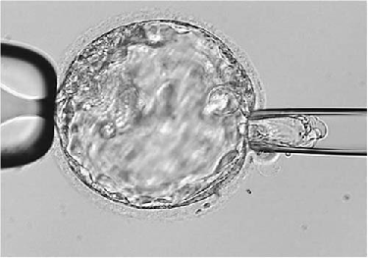
Genetic Testing of Embryos
If your treatment plan includes genetic testing of your embryos, there is a handout in your folder that will instruct you to watch an educational video and sign a consent form with the lab performing the genetic testing.
This process must be completed before you start stimulation medications.

Slide 11
Treatment Plans
Your physician has determined which treatment plan is best for your circumstances.
Antral follicle count, ovarian reserve testing, age, diagnosis, and previous IVF history all factor into the protocol that has been chosen for you.
Not all patients take the same medications.
Medication dosages are also going to vary from patient to patient.

Slide 12
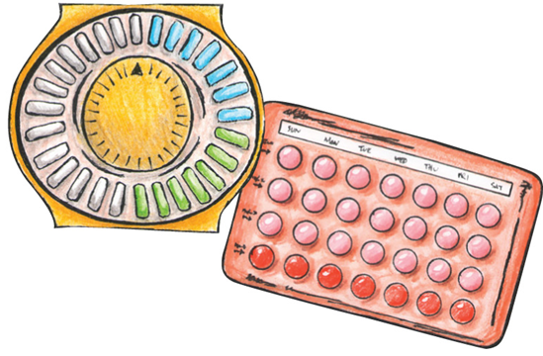
Birth Control Pills
Birth control pills may be a part of your treatment plan.
They are usually started the month before your IVF cycle.
Call with the first day of your full flow period, the month before your IVF cycle, to determine when and if you need to start birth control pills.
You will be given a date to start and stop the pills.
Please be aware that you may have some bleeding after you stop the pill. This is normal and will not affect your treatment cycle.
If you are not taking birth control pills, call with the first day of your full flow period, the month before your IVF cycle.

Slide 13

Birth Control Pills
Take active birth control pills only, unless instructed otherwise. There are 21 active pills and 7 placebo pills in each pack of pills.
We recommend that you take the pill in the evening to help minimize side effects.
If you finish the 21 active birth control pills, begin a new pack. DO NOT take the placebo pills.
You can contact your pharmacy for a refill.
Birth Control Pills
This is an example of a birth control pill pack
The 21 blue pills are the active pills
The 7 white pills are placebo pills. There are no hormones in these pills. Do not take the placebo pills.

Slide 14
FINALLY!!! TIME TO BEGIN!!!!

Slide 15

Cycle Calendar
The calendar serves as a guide during your cycle.
Make multiple copies of your calendar and keep at home, in your car, in your purse, and at work. Give one to your partner, too.
You will need to reference your calendar frequently.
DATES ARE TENTATIVE!
Medications doses are left blank after a certain point. You will receive updated medication instructions through your patient portal each day you have a monitoring appointment.
WE DO NOT PRE-SCHEDULE EGG RETRIEVALS. You will have a 2 day notice.

Slide 16

Starting Injections
Your cycle calendar has the date you are to start injections.
Once you start your injections, you must be available at all times.
DO NOT make any travel plans during your cycle.
Most patients require 10 to 12 days of injections before they ready for egg retrieval.
Remember to keep track of your home medication inventory in order to determine if you need to call your pharmacy for refills.
It is very important to be easily reached during your cycle.

Slide 17

Monitoring Appointments
All monitoring appointments are scheduled in the morning only. This allows time for ultrasound and blood work results to be processed and reviewed by your physician.
These appointments may interfere with your work schedule.
The number of monitoring appointments scheduled during a cycle is determined by your individual response to the medications. Anticipate 5-7 appointments before retrieval.
We do not pre-schedule monitoring appointments.
Your ovaries are the boss! The number of monitoring appointments it determined by how your ovaries respond to the medications.

Slide 18

Patient Portal Messages
All results and medication instructions will be communicated through your patient portal during your cycle.
On the day of each monitoring appointment, you will receive a text message prompting you to log in to your patient portal.
Updated medication dosages and instructions and the date and time for your next appointment will be included in the message.
If you have questions about the information in your message, call the office before 4 PM CST to discuss.
There may be days that you will not receive a message until after 4 PM CST.
Always be available by phone on the day of monitoring appointments in the event that we need to call you to discuss results or instructions.

Slide 19
DO’s and DON’Ts
  DO take a prenatal vitamin daily. These can be purchased over the counter at any pharmacy.
  DO Avoid high impact exercise (spinning, running, Zumba etc.)
  Low impact exercise is okay (swimming, walking, etc.)
  Okay to have protected intercourse while on stimulation medications, based upon comfort level.
  Unless one of our MDs states otherwise, DO avoid Motrin, Advil, Aleve, and Aspirin products while on stim meds.
  Tylenol and Tylenol cold products are okay.

Slide 20

Ready to go to the show…you have been triggered
Your physician has determined that maximum follicular development has been achieved and it’s time to schedule your egg retrieval.
You will receive a phone call to review your trigger and egg retrieval instructions. These instructions are in your IVF folder. Please have them with you when we call.
You must know the name and dose of the trigger shot that you have at home. This will affect the instructions that are reviewed with you.
You will be instructed to administer your trigger shot at a specific time (36 hours prior to your egg retrieval, unless instructed otherwise).
IT IS CRUCIAL THAT YOU GIVE YOUR TRIGGER INJECTION AT THE CORRECT TIME!

Slide 21
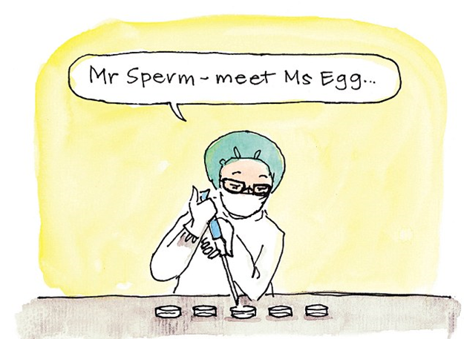
Day of Egg Retrieval
You will be instructed to arrive at Boston IVF at a specific time.
Detailed instructions are attached to your email and should have already been reviewed.
When you arrive, please have a seat in the waiting room and a nurse will be right with you. Front office staff will not be there.
You and your partner will be brought back to the procedure area. Only one person is allowed back in the procedure area with you.
Your physician and anesthesiologist will speak with you before your procedure.
Post retrieval instructions will be reviewed.
The retrieval takes about 20-30 minutes.
You will be informed of the total number of eggs retrieved before you are released.
About an hour after retrieval is complete, you are discharged to go home.
Someone must be with you at all times.
You are not allowed to drive or go to work on the day of retrieval.

Slide 22

Day After Egg Retrieval
You will receive a notification with your fertilization results. This information will be available on your patient portal.
If you are having an embryo transfer, transfer instructions will be reviewed via a phone call.
You will not receive any further calls to discuss the status of your embryos. Your physician will review embryo development with you on the day of your transfer.
You are allowed to return to work the day after egg retrieval.

Slide 23
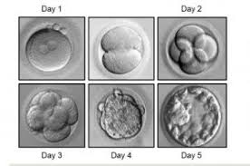
Day of Embryo Transfer
You will be given a specific time to arrive at BIVF.
Bring your photo ID and a pair of warm socks.
Remember to fill your bladder.
Your partner can be with you in the procedure room during the transfer.
DO NOT wear any perfumes, scented lotions, body sprays, etc on the day of transfer. This applies to your partner, as well. Deodorant is fine.
If you are using vaginal progesterone support, do not take your morning dose. Bring medication with you to insert after your transfer.
You are allowed to go back to work.
Blood pregnancy testing is scheduled 9 or 11 days after your transfer.
If you start your period, you still need to have blood pregnancy test drawn.

Slide 24
If you are not having a fresh embryo transfer
One week after your egg retrieval, log in to your patient portal to review the number of embryos that have been cryopreserved.
Specific questions regarding your embryos will be discussed during your scheduled phone consult.
Call with the first day of your full flow period.
If you are proceeding with a frozen embryo transfer cycle, details for that cycle will be discussed when you call with cycle day 1.
  Your Frozen Embryo Transfer may line up to occur with the next month OR you may have to delay a month depending on the timing of your menses and the dates for the “batch.”
Baseline testing may need to be scheduled or you may be started on birth control pills.

Slide 25
Ovarian Hyperstimulation Syndrome (OHSS)
OHSS usually occurs in women taking medications that stimulate the ovaries.
Symptoms typically start in the days following egg retrieval.
Common symptoms to look out for include lower abdominal pain, bloating, nausea, vomiting, diarrhea, shortness of breath/difficulty breathing, fatigue, and a weight gain of 2 or more pounds 2 days in a row.
If you experience any of the above symptoms, call our office.
If it is after hours or you are having severe symptoms, please go to The Women’s Hospital Emergency Department or the closest emergency room.

Slide 26

Taking Care of You
Fertility treatments are stressful and sometimes you may need a little help to get through.
The Women’s Hospital Center for Healing Arts offers counseling services, acupuncture, and massage.
For acupuncture and massage appointments, call (812) 842-4328.
To schedule a counseling appointment with Dr. Libby Brown, call (812) 842-4020.

Slide 27
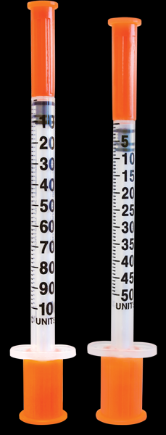


Calendar

Slide 28
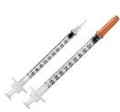
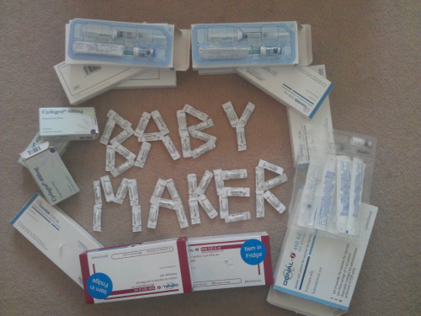




Slide 29

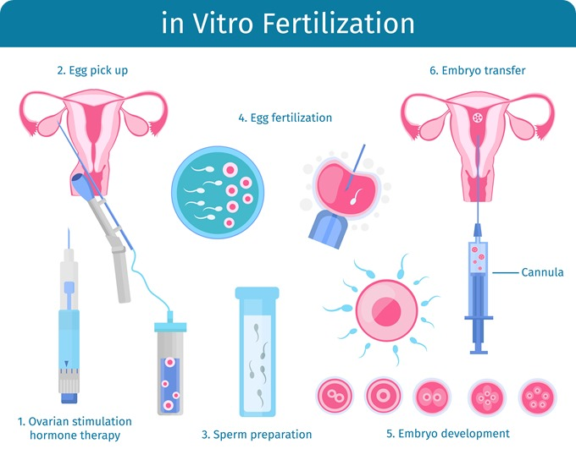


Slide 30

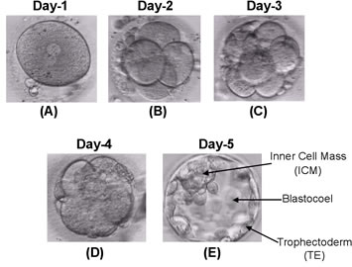


Slide 31
